Slide 1
Searching Algorithms Lecture 6

Slide 2
Searching
Searching is a process of checking and finding an element from a list of elements.
Following are the two important searching techniques :
1. Linear or Sequential Searching
2. Binary Searching
Notes:
Searching is a process of checking and finding an element from a list of elements. Let A be a collection of data elements, i.e., A is a linear array of say n elements. If we want to find the presence of an element “data” in A, then we have to search for it. The search is successful if data does appear in A and unsuccessful if otherwise

Slide 3
LINEAR OR SEQUENTIAL SEARCHING
A sequential search of a list/array begins at the beginning of the list/array and continues until the item is found or the entire list/array has been searched.
The linear (or sequential) search algorithm on an array is:
Sequentially scan the array, comparing each array item with the searched value.
If a match is found; return the index of the matched element; otherwise return –1.
Notes:
In linear search, each element of an array is read one by one sequentially and it is compared with the desired element. A search will be unsuccessful if all the elements are read and the desired element is not found.

Slide 4
ALGORITHM FOR LINEAR SEARCH
Let A be an array of n elements, A[1],A[2],A[3], ...... A[n]. “data” is the element to be searched. Then this algorithm will find the location “loc” of data in A. Set loc = – 1,if the search is unsuccessful.
Input an array A of n elements and “data” to be searched and initialize loc = – 1.
Initialize i = 0; and repeat through step 3 if (i < n) by incrementing i by one .
If (data = A[i])
(a) loc = i
(b) GOTO step 4
If (loc > 0)
(a) Display “data is found and searching is successful”
Else
(a) Display “data is not found and searching is unsuccessful”
Exit

Slide 5
//PROGRAM TO IMPLEMENT SEQUENTIAL SEARCHING
//CODED AND COMPILED USING TURBO C
#include<conio.h>
#include<stdio.h>
void main()
{
char opt;
int arr[20],n,i,item;
clrscr();
printf (“\nHow many elements you want to enter in the array : ”);
scanf (“%d”,&n);
for(i=0; i < n;i++)
{
printf (“\nEnter element %d : ”,i+1);
scanf (“%d”, &arr[i]);
}
printf (“\n\nPress any key to continue....”);
getch();
do
{
clrscr();

Slide 6
printf (“\nEnter the element to be searched : ”);
scanf (“%d”,&item); //Input the item to be searched
for(i=0;i < n;i++)
{
if item == arr[i])
{
printf (“\n%d found at position %d\n”,item,i+1);
break;
}
}/*End of for*/
if (i == n)
printf (“\nItem %d not found in array\n”,item);
printf (“\n\nPress (Y/y) to continue : ”);

Slide 7



Search Algorithms
Suppose that there are n elements in the array. The following expression gives the average number of comparisons:
It is known that
Therefore, the following expression gives the average number of comparisons made by the sequential search in the successful case:

Slide 8
Linear Search Tradeoffs

Slide 9
TIME COMPLEXITY
Time Complexity of the linear search is found by number of comparisons made in searching a record.
In the best case, the desired element is present in the first position of the array, i.e., only one comparison is made. So f (n) = O(1).
In the Average case, the desired element is found in the half position of the array, then f (n) = O[(n + 1)/2].
But in the worst case the desired element is present in the nth (or last) position of the array, so n comparisons are made. So f (n) = O(n + 1).

Slide 10
BINARY SEARCH
Divide-and-conquer strategy.
It uses a recursive method to search an array to find a specified value.
The array must be a sorted array:
a[0]≤a[1]≤a[2]≤. . . ≤ a[finalIndex]
If the value is found, its index is returned.
If the value is not found, -1 is returned.
Note: Each execution of the recursive method reduces the search space by about a half.

Slide 11
BINARY SEARCH
Find the middle element of the array (i.e., n/2 is the middle element if the array or the sub-array contains n elements).
Compare the middle element with the data to be searched, then there are following three cases.
If it is a desired element, then search is successful.
If it is less than desired data, then search only the first half of the array, i.e., the elements which come to the left side of the middle element.
If it is greater than the desired data, then search only the second half of the array, i.e., the elements which come to the right side of the middle element.
Repeat the same steps until an element is found or exhaust the search area.

Slide 13
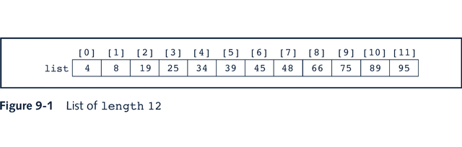
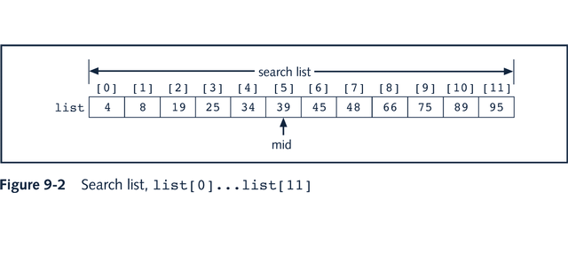
Binary Search

Slide 14
Binary Search: middle element
left + right
mid =
2

Slide 15
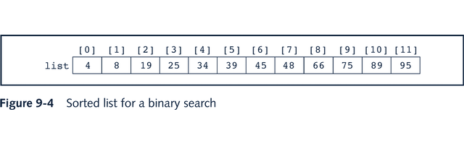
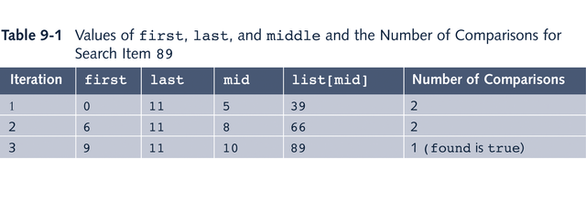
Binary Search: Example

Slide 16
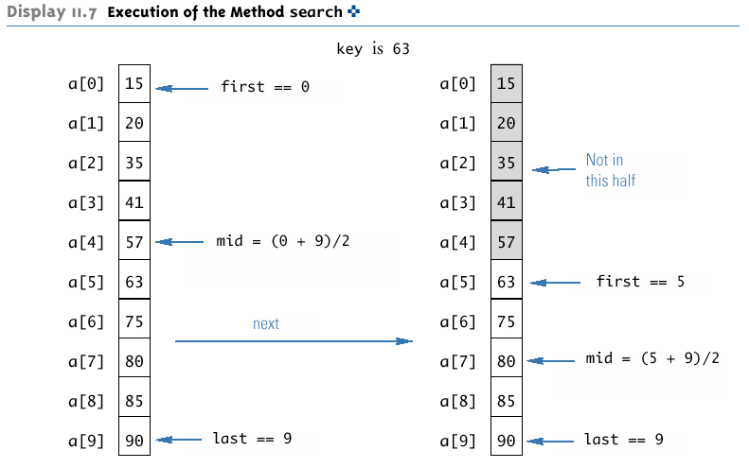
Execution of the Method search (Part 1 of 2)

Slide 17
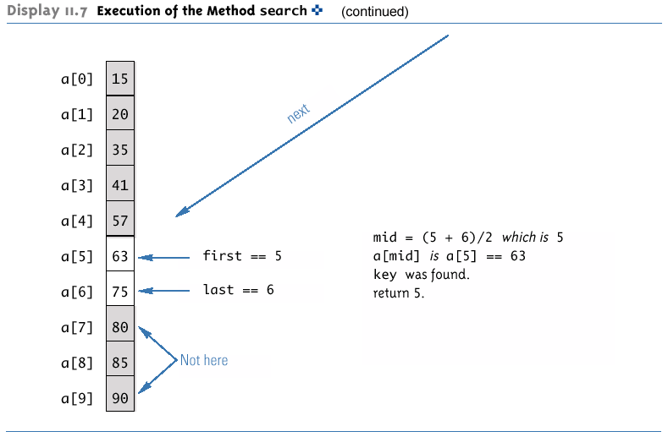
Execution of the Method search (Part 2 of 2)

Slide 18
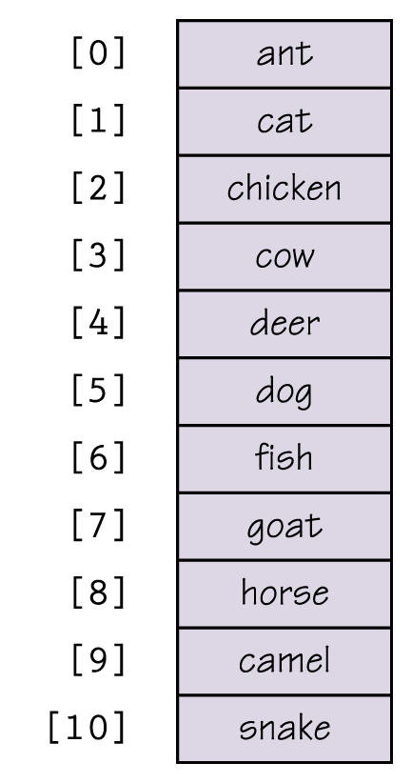
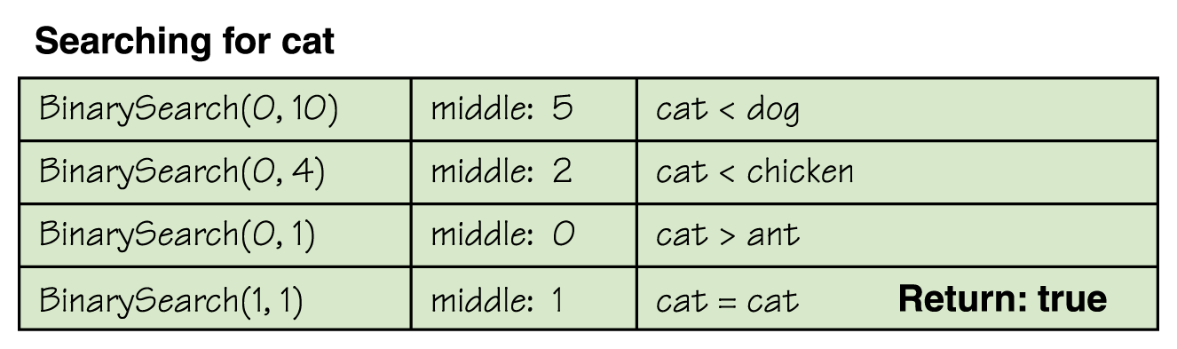
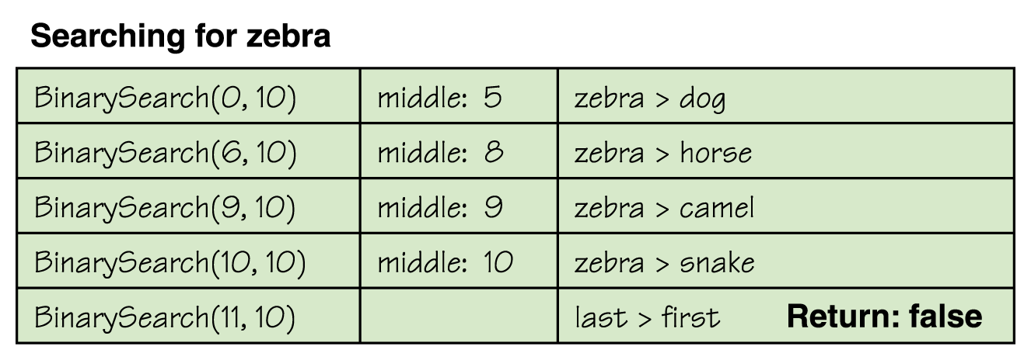
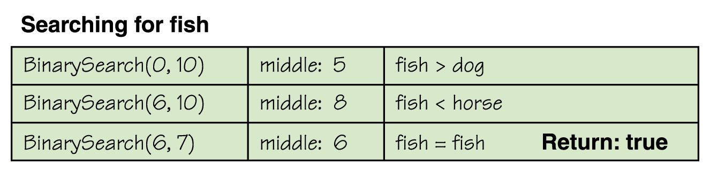
Binary Search

Slide 19
Efficiency of Binary Search
The binary search algorithm is extremely fast compared to an algorithm that tries all array elements in order.
About half the array is eliminated from consideration right at the start.
Then a quarter of the array, then an eighth of the array, and so forth.

Slide 20
Efficiency of Binary Search
Given an array with 1,000 elements, the binary search will only need to compare about 10 array elements to the key value, as compared to an average of 500 for a serial search algorithm.
The binary search algorithm has a worst-case running time that is logarithmic: O(log n)
A serial search algorithm is linear: O(n)
If desired, the recursive version of the method search can be converted to an iterative version that will run more efficiently.

Slide 21
ALGORITHM FOR BINARY SEARCH
Input an array A of n elements and “data” to be sorted
LB = 0, UB = n; mid = int ((LB+UB)/2)
Repeat step 4 and 5 while (LB <= UB) and (A[mid] ! = data)
If (data < A[mid])
(a) UB = mid–1
Else
(a) LB = mid + 1
Mid = int ((LB + UB)/2)
If (A[mid]== data)
(a) Display “the data found”
Else
(a) Display “the data is not found”
Exit

Slide 22
PROGRAM FOR BINARY SEARCH
#include<conio.h>
#include<stdio.h>
void main()
{
char opt;
int arr[20],start,end,middle,n,i,item;
clrscr();
printf (“\nHow many elements you want to enter in the array : ”);
scanf (“%d”,&n);
for(i=0; i < n; i++)
{
printf (“\nEnter element %d : ”,i+1);
scanf (“%d”,&arr[i]);
}
printf (“\n\nPress any key to continue...”);
getch();
do
{
clrscr();
printf (“\nEnter the element to be searched : ”);
scanf (“%d”,&item);
start=0;
end=n – 1;
middle=(start + end)/2;

Slide 23
PROGRAM FOR BINARY SEARCH
while(item != arr[middle] && start <= end)
{
if (item > arr[middle])
start=middle+1;
else
end=middle-1;
middle=(start+end)/2;
}
if (item==arr[middle])
printf(“\n%d found at position %d\n”,item,middle + 1);
if (start>end)
printf (“\n%d not found in array\n”,item);
printf (“\n\nPree (Y/y) to continue : ”);
scanf (“%c”,&opt);
}while(opt == ‘Y’ || opt == ‘y’);
}/*End of main()*/

Slide 24
Sources used
Lectures by Mr. Mohammad Asad Abbasi

